Slide 1


Nucleon knockout reactions with heavy nuclei
Edward Simpson
University of Surrey
Brighton PRESPEC Meeting
12th January 2011

Slide 2
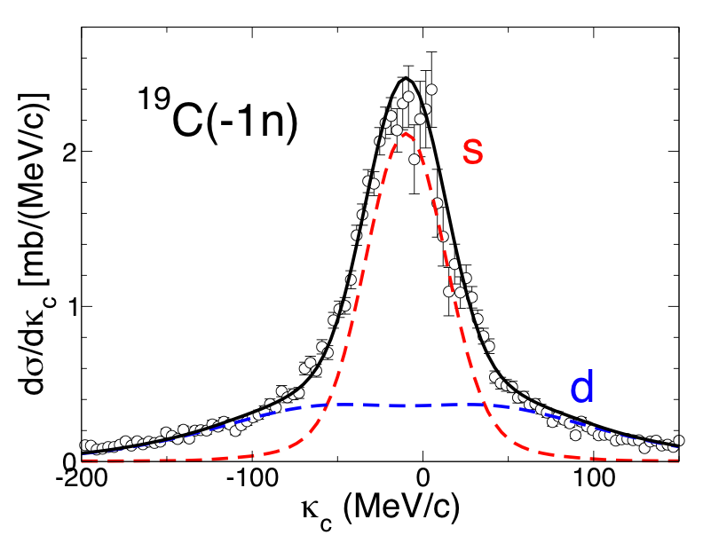
Nucleon knockout reactions
Removal of nucleons from a (secondary radioactive) beam at energies >80 MeV/nucleon on a light nuclear target (Be, Carbon)
Halos: ¹⁵C, ¹⁹C, ²⁷P, ³¹Ne
Magic numbers: ²⁴O, ⁴²Si
Exotic R_{s}: ²³Al, ²³Si, ²⁷P, ²⁷S
Momentum distributions
Orbital angular momentum – final state spins, evolution of shell ordering
Width increases with nucleon binding energy
Absolute cross sections
Cross section proportional to spectroscopic strength
Suppression of spectroscopic strengths in asymmetric systems
Hansen et al., Annu. Rev. Nucl. Part. Sci. 53, 219 (2003)
Notes:
Before we get on to two-nucleon knockout it self…
Single-nucleon knockout has been extensive used to study near-fermi surface nuclear structure
Halo nuclei, new and absent magic numbers, suppression of shell-model strength for both strong and weakly bound nucleons, and also in the island of inversion, mentioned above.
Absolute cross sections probed spectroscopic strengths
Residue longitudinal momentum distributions give information on nucleon angular momentum
Structural and reaction dynamics aspects are factored

Slide 3
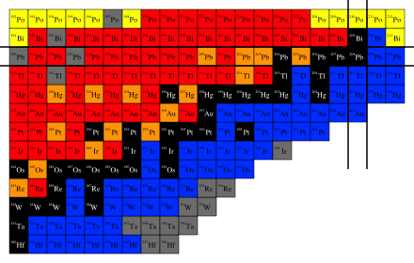
Knockout in heavy nuclei
✖ | Two-step fragmentation (secondary beam)
✖ | Smaller cross section
? | Requires prompt γs
✔ | Simple direct reaction mechanism
✔ | Predictable final state exclusive cross sections
✔ | Rich structural information

Slide 4
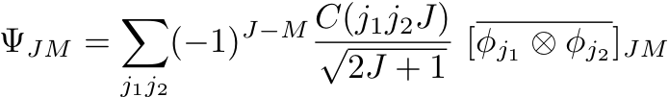
Two-nucleon knockout
Two-nucleon
overlap (J_{i}=0)
Two-nucleon amplitude (TNA)
Two-nucleon
wave function
Oxbash TNA using khhe interaction in proton [2s_{1/2}, 1d_{3/2}, 0h_{11/2}, 1d_{5/2}, 0g_{7/2}] model space, final state spin defined by valence nucleons: j₁+j₂=J
Woods-Saxon radial wave functions, constrained by HF r.m.s. radii
Optical-limit elastic S-matrices, density folding model, (HF calculations, reaction cross sections)
PRC 70, 064602 (2004); PRC 74, 064604 (2006);EPJ ST 150 67 (2007)
Notes:
Two-nucleon overlap – coherent sum of (shell-model) two-nucleon amplitudes
Anti-symmetrized two-nucleon wave function, constrained by HF
Elastic scattering S-matrices constrained reaction cross sections (if available) and/or HF density profile calculations.
Magnitude of TNA determines absolute cross section, angular momentum coupling gives momentum distribution
CROSS SECTIONS – SPECTROSCOPIC STRENGTHS
MOMENTUM DISTRIBUTIONS – ANGULAR MOMENTUM CONTENT

Slide 5











Residue momentum distributions
Distribution sensitive to J_{f}
[Fast spectator]
κ_{c} probed by K_{A} and K_{c} in the lab frame
[PRL 102, 132502 (2009); PRC 79, 064621 (2009)]
Notes:
Projectile description
Probe nucleon pair momentum by measuring final residue momentum
Key is that momentum distribution depends sensitively on the final state spin (if spin-zero)
Spherical Shell model! Not (currently) applicable to deformed systems, work in progress..

Slide 6
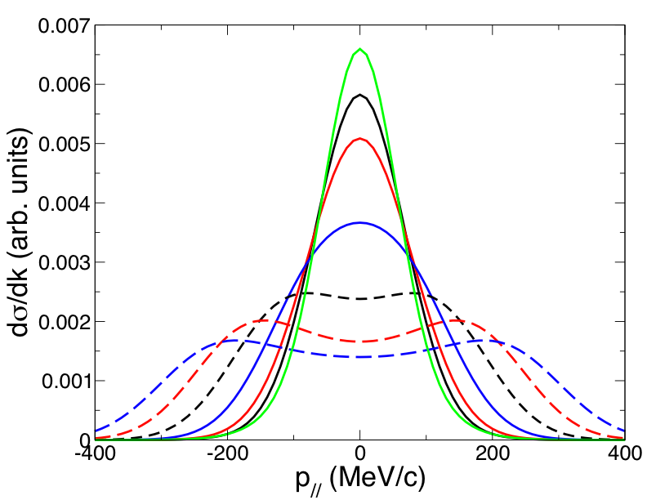
²⁰⁸Pb(-2p) [0h_{11/2}]² Distribution
Projectile
rest frame
[2s_{1/2}]²
0⁺
0⁺
2⁺
[0h_{11/2}]²
4⁺
κ_{c}
6⁺
8⁺
10⁺
κ_{c}
Notes:
Example calculation – width in projectile rest frame varies!
Primary sensitivity to final state angular momentum
IMPORTANT IN THE CONTEXT OF HIGH-SPIN ISOMERIC STATES
ISOMERIC RATIO SHOULD VARY AS A FUNCTION OF MOMENTUM, DEPENDS ON FEEDING
CAN LEAD TO CUTTING OF ISOMER…

Slide 7
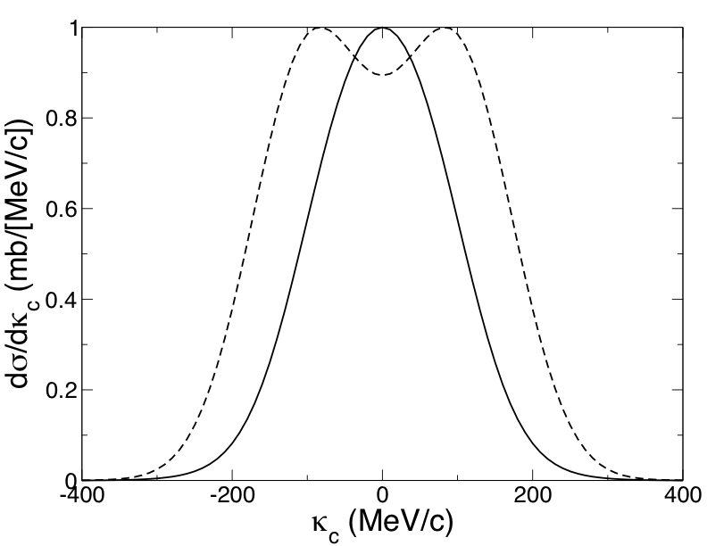
Sensitivity to underlying structure
²⁰⁶Hg 3⁺ states
Same final state spin, different residue momentum distributions due to the underlying structure
(arb.units)
[2s_{1/2}][0g_{7/2}]L=4
[2s_{1/2}][1d_{5/2}] L=2
Notes:
… The final state spin is not the only factor; the underlying structure is important!

Slide 8
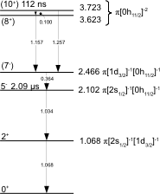
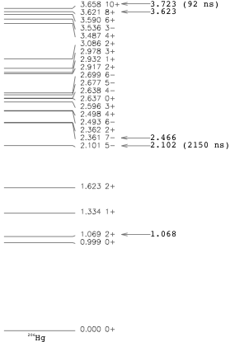
²⁰⁸Pb(-2p): RISING Isomer Decay
Shell Model (52) Experiment (6)
Many states are expected to be populated, with σ~0.1 mb.
Density of states much higher than in light nuclei.
Most states unobserved – isomer decay only
PRC 65, 064604 (2001); PRL 87, 212501 (2001)
Notes:
IN PRINCIPLE THE MOMENTUM DISTRIBUTION FOR A PARTICULAR STATE CAN TEL YOU SOMETHING ABOUT THE SPIN
THE COMPLICATION FOR ISOMER DECAY SPECTROSCOPY IS ALL THE UNOBSERVED STATES….

Slide 9
²⁰⁸Pb(-2p): Isomeric ratios
Reasonable agreement once feeding is included
Unobserved feeding?
Cuts on momentum, affects high-spin states?
Isomeric state | Isomeric ratio, R_{I} (%)
5⁻ (exp) | 21.9(+1.2,-2.9)
5⁻ (theory) | 4.8
5⁻ (theory: 5⁻, 7⁻, 8⁺, 10⁺) | 18.8 [Unobserved feeding?]
10⁺ (exp) | 3.1(+1.0,-1.2)
10⁺ (theory) | 4.7 [Differential cutting by slit?]
PRC 78, 061302 (2008); Int. J. Mod. Phys. E 18, 1002 (2008);
PRC 80, 064608 (2009)
Notes:
Isomeric ratios from calculations compared to experiment
Unobserved feeding… Implications for momentum distribution?
Differential cutting? Need to know exact position of the slits…

Slide 10
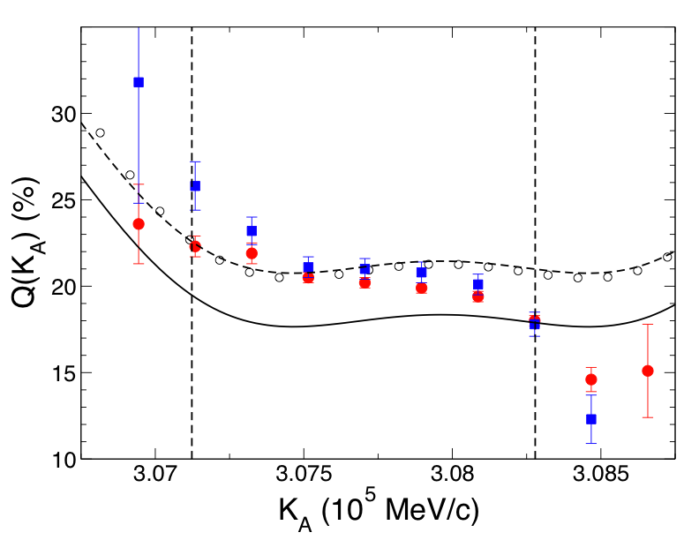
²⁰⁶Hg differential isomeric ratios
Correction for unobserved feeding
Fully-stripped
Hydrogen-like
Z. Phys. A. 250, 215 (1994); PRC 63, 064609 (2001)
Notes:
This shows the isomeric ratio as a function of the residue momentum
Previous experiments have shown a similar strong sensitivity
Despite strong broadening, some sensitivity still remains… but weak!
… But much of the sensitivity is removed… HOWEVER…

Slide 11
Conclusions/Further work
Full exploitation of the mechanism requires prompt gamma rays…
… and ideally final state exclusive residue momentum distributions
Tests of mechanism – single nucleon knockout (using thin target) e.g. ²⁰⁸Pb(-1p) --> ²⁰⁷Tl, secondary reactions with “isomeric” beam?
Deformed nuclei requires theoretical development, structure and reaction dynamics

Slide 12
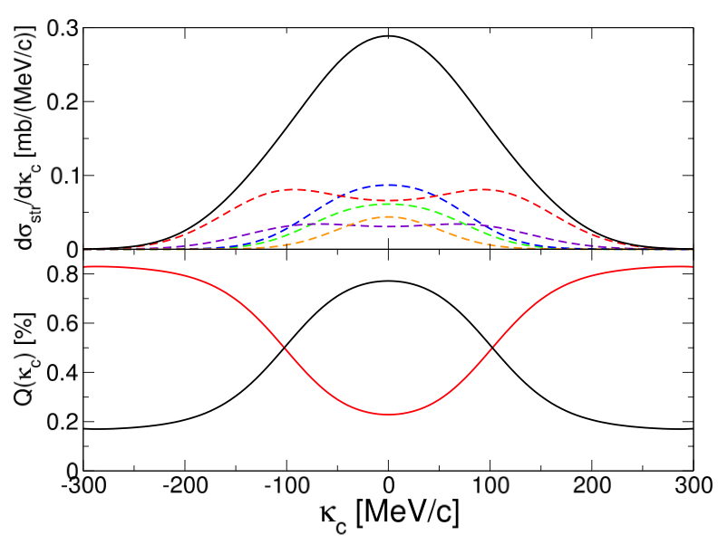
²⁰⁸Pb(-1p): test case?
Isomer: 1.33 s proton [0h_{11/2}]⁻¹ hole state at 1.348 MeV
Simple: five proton-hole states populated
Large cross section (~10s of mb)
Thin target: sensitivity of isomeric ratio to momentum
Total
2s_{1/2}
1d_{3/2}
0h_{11/2}
1d_{5/2}
0g_{7/2}
Momentum
distribution
Isomer
Population
fraction
Non-isomer

Slide 13


Acknowledgements
J. A. Tostevin, P. H. Regan
Zs. Podolyak, S. J. Steer
B. A. Brown
UK STFC Grants EP/D003628 and ST/F012012
UK EPSRC Grant EP/P503892/1
Notes:
Thanks for listening

Slide 14
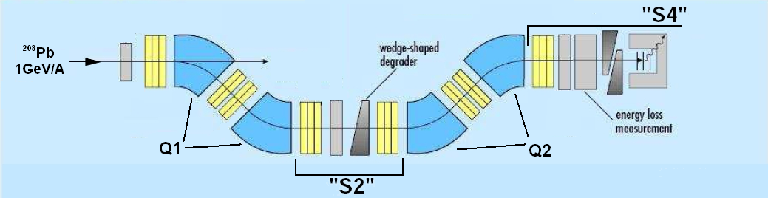
RISING: Isomer decay spectroscopy
Thick ⁹Be reaction target: many final states populated, prompt decay unobserved, momentum distribution broadened
Fragment position measured at S2 converted to momentum
S1 slits remove primary beam but cut residue momentum distribution (not at focal plane!)
Residues stopped and isomer decay observed
Notes:
Residue momentum depends target factors, differential energy loss, unknown reaction vertex
Slits at S1 remove beam, cut residue momentum distribution – affect isomeric ratios!
Position at S2 can converted to momentum…
Isomer decay observed at end of FRS…

Slide 15
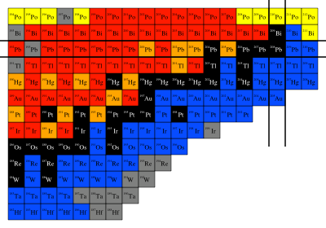
²⁰⁸Pb(-2p): Thresholds
Separation thresholds ensure ²⁰⁶Hg residues populated directly
5⁻ and 10⁺ isomers are populated. 7⁻ and 8⁺ states are observed in subsequent gamma cascades
9.50
π
-1p
6.73
ν
-1n
11.093
3.723
10⁺
2.102
5⁻
56 states are populated, only a few of which are observed following the decay of the isomeric states
π
7.38
ν
²⁰⁶Hg
+15.381
6.85
-1p
-2p
+8.01
²⁰⁷Tl
7.37
ν
²⁰⁸Pb
Notes:
Residue populated directly; thresholds AND single-particle strength.
Several isomers are populated, amongst many other states that are unobserved

Slide 16
Overview
Knockout: what can we learn from cross sections and momentum distributions?
Heavy nuclei: complications
Example: Isomers in ²⁰⁸Pb(-2p)
New experiments: mechanism tests, isomeric beams?

Slide 17
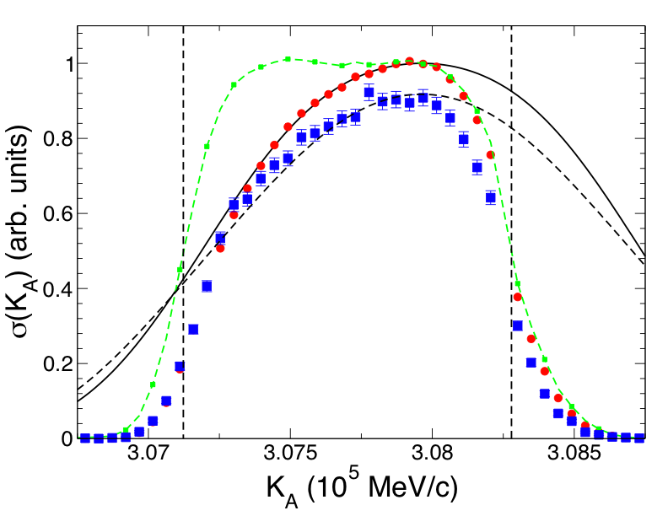
²⁰⁶Hg momentum distributions
Target broadened
-7.7 mm
+0.3 mm
Exp/Th
Total
5⁻(×5)
PRC 82, 037602 (BR) (2010)
Notes:
Hg206 experimental momentum distributions – strong target broadening!
Target broadening taken into account using LISE post-target beam profile… We also require a small downward shift in momentum.

